Slide 1
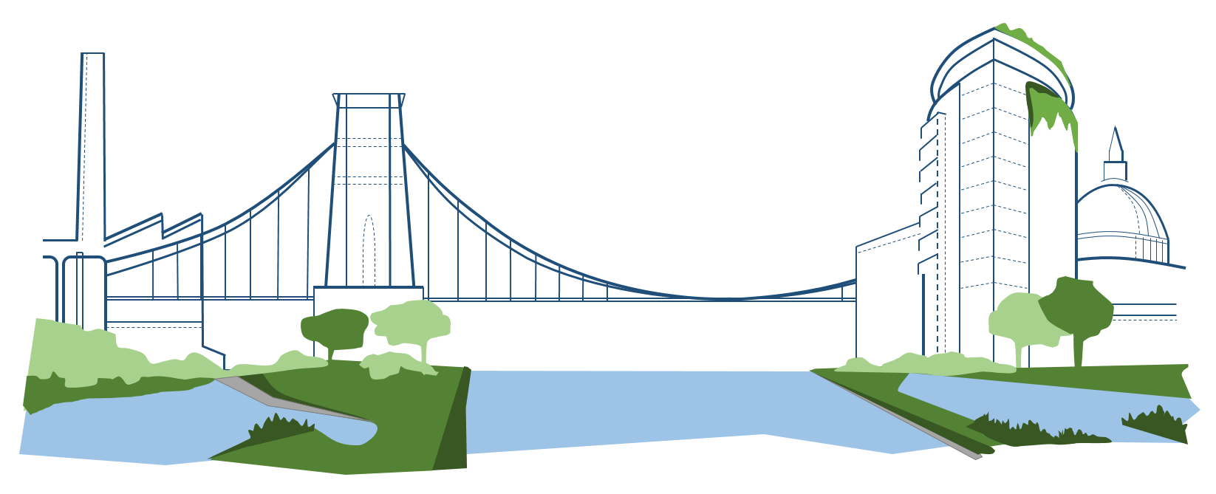
Urban Flood Resilience in an Uncertain Future
www.urbanfloodresilience.ac.uk Urban Flood Resilience @BlueGreenCities

Slide 2
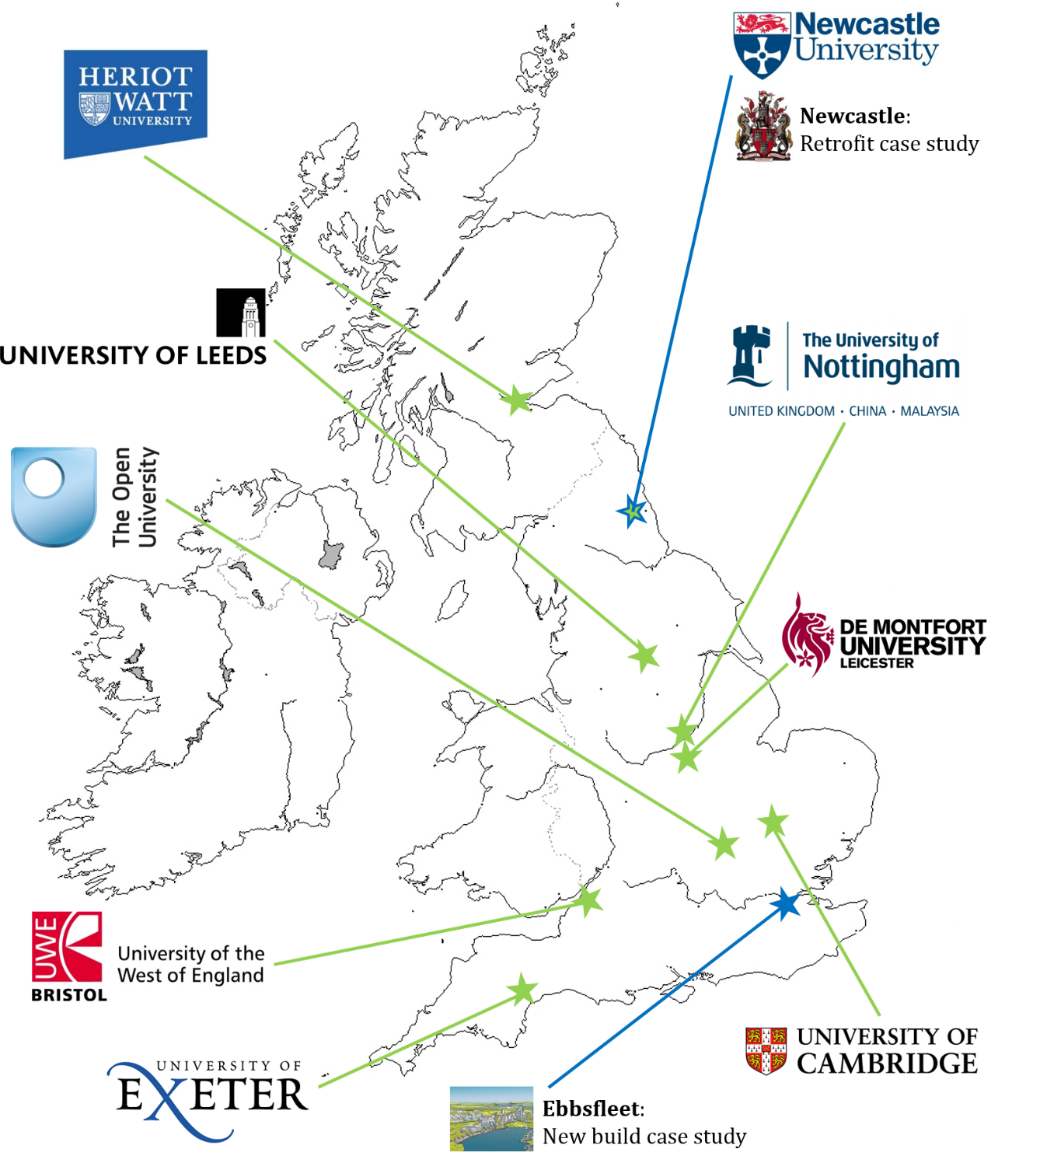
UK Urban Flood Resilience Research Consortium

Slide 3
Aim
Make urban flood resilience achievable in an uncertain future, by making transformative change possible through adoption of the whole systems approach to urban flood and water management

Slide 4
Urban Flood Resilience
A city’s capacity to maintain future flood risk at acceptable levels by:
preventing deaths and injuries,
minimising damage and disruption during floods,
recovering quickly afterwards,
ensuring social equity,
protecting the city’s cultural identity and economic vitality

Slide 5
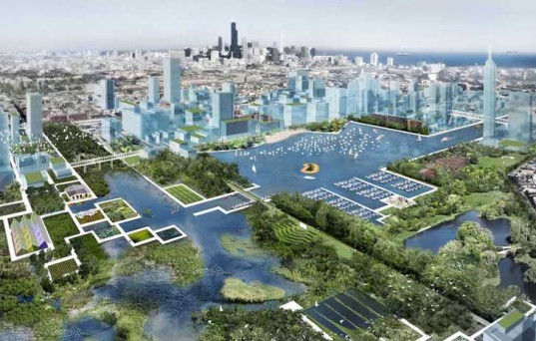
Resilient Blue-Green Cities
Image: https://www.contradodigital.com/wp-content/uploads/2014/06/Blue-Green-City.jpg

Slide 6
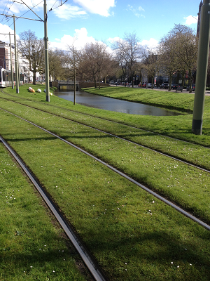
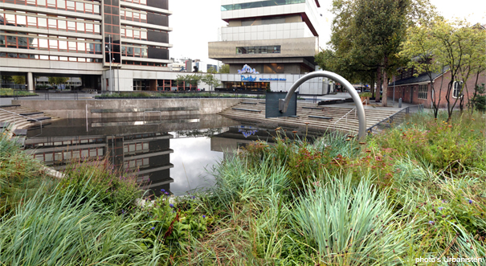
Changing the Water Narrative:
stormwater is not just a nuisance
but presents opportunities to make cities
Resilient, Attractive, Competitive and Liveable

Slide 7
Research Impact
Step change in protecting UK cities and national economy from increased storminess, without constraining urban development and growth.
Envisioning and delivering a different water future: urban flood and water management that is:-
planned
developed
operated
sustainably and with multiple benefits

Slide 8
Urban Flood Resilience Research Themes
Engineering Design of integrated Blue/Green and Grey (B/G+G) surface water treatment trains that support resilient management of water quantity and quality
Planning that puts urban flood risk management at the heart of urban planning & focuses on interfaces between planners, developers, engineers and communities
Development of flood and water management assets that function inter-operably with other urban systems: transport, energy, land-use and natural systems

Slide 9
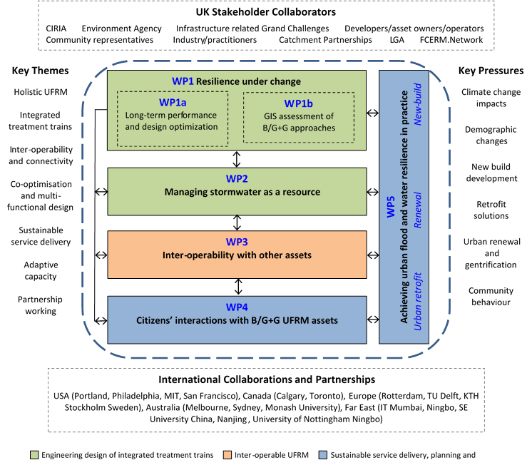

Slide 10
Deliverables 1: Engineering design
Next generation flood and water management models Urban/rural and engineered/natural water systems that provide acceptable service 365 days a year (WP1a)
Integrated Stormwater ‘treatment trains’ Adaptable designs and drainage pathways appropriate to their location, community and scale (WP1a)
GIS toolbox for a National Assessment of Urban Flooding B/G+G Infrastructure to handle increased variability, flood risk, sewer capacity, and stormwater resource potential under future urban development and climate change (WP1b)

Slide 11
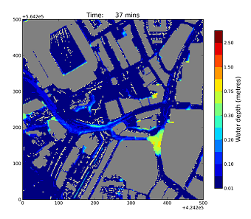
WP1a. Long-term performance and design optimization
Optimise B/G+G and SuDS system performance under a range of future scenarios for climate and socio-economic change
24/7, 365 service provision: resilient to increased climatic variability
Whole systems approach: making best possible use of urban green spaces to manage urban water cycle

Slide 12
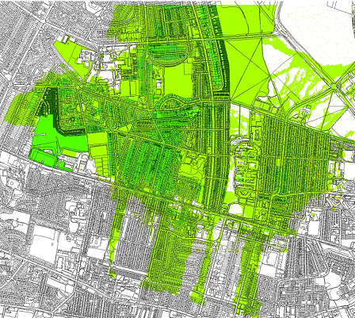
WP1b. GIS assessment of B/G+G approaches
GIS-toolbox to support comparative evaluation of the costs and benefits of alternative urban flood risk management solutions
Integrated maps of flood risk reduction and co-benefits, e.g. carbon sequestration, habitat improvement, greenspace access
Future scenarios for climate change, socio-economic development, and damage & disruption reductions using integrated B/G+G systems

Slide 13
Deliverables: Engineering for urban water resource use across drought – flood spectrum
Enhanced design methods that both mitigate flood hazards and treat stormwater as a resource - leading to stormwater capture, recycling and reuse (WP2)
Improved integration of urban flood risk management and water, energy and transport infrastructure and expanded inter-operability of urban systems-of-systems (WP3)

Slide 14
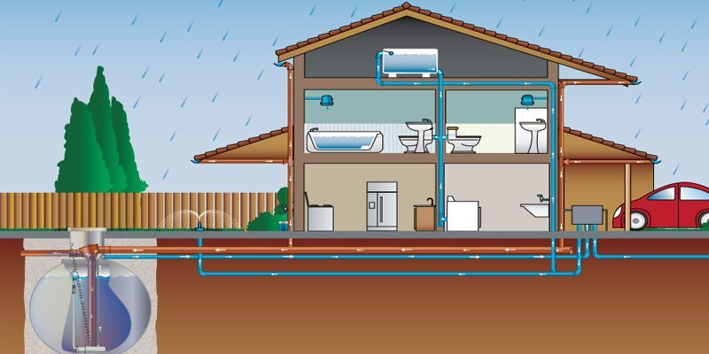
WP2. Managing stormwater as a resource
Potential for stormwater use within buildings, irrigation, managing subsidence, groundwater recharge, micro-hydropower, enhancing recreation and ecosystems services
Rainwater harvesting under climate change
Stormwater development and resource potential
Stormwater retention for biodiversity in urban streams, green spaces and corridors
Cumulative effects of B/G+G treatment trains on urban stream forms and functions

Slide 15
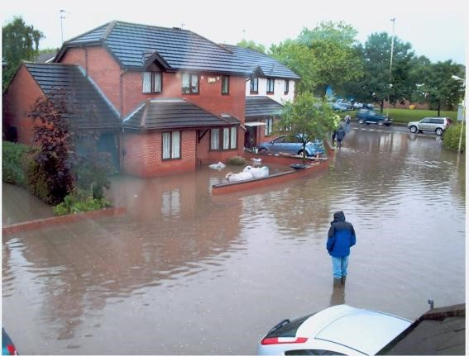
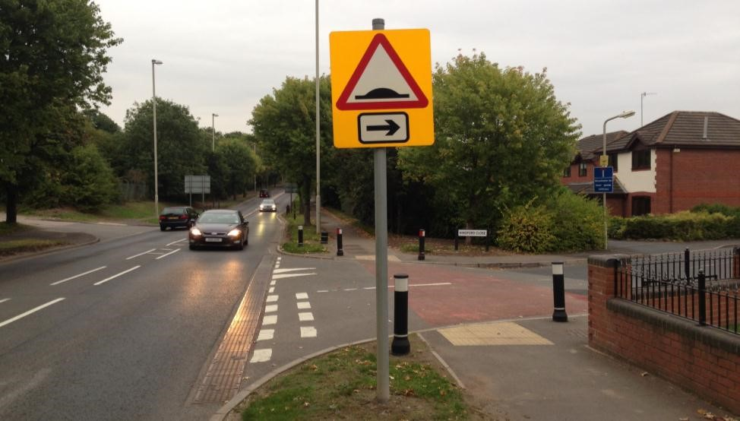
WP3. Interoperability with other systems
Potential for inter-operable B-G/G design solutions to increase flood resilience across urban infrastructure systems
Optimise use stormwater management solutions to interoperate with existing infrastructure assets;
Increase functionality of designs for greater efficiency and productivity while reducing overall costs

Slide 16
Deliverables: social and planning aspects of urban flood risk management
Characterise citizen’s behaviours and decision making on flooding and urban water use, and informing decisions through improved flood risk and water literacy (WP4)
New protocols placing flood and water management decision making at the heart of urban planning recommended by Pitt (2008) and 2010 Flood and Water Management Act (WP5)
Case studies demonstrating enhanced urban flood and water management in retrofit, renewal, new town applications (WP5)

Slide 17
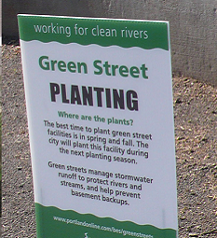
WP4. Citizen’s Understanding and Attitudes
Understand how to transform attitudes and change behaviour s of flood professionals and urban residents
1. New mechanisms for engaging communities, improving flood awareness and communicating benefits (e.g. social media)
2. How citizens’ priorities and lifestyles, affect public understanding of and support for B/G+G
3. Changing attitudes, perceptions and opinions to shift attitudes and behaviours with respect to B/G+G

Slide 18
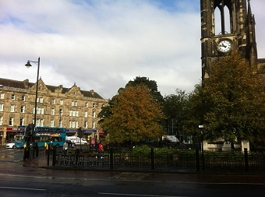
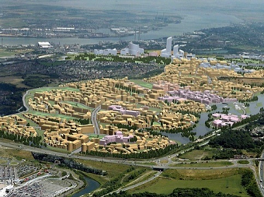
WP5. Achieving urban flood and water resilience in practice
Inform, take-up and apply research in WPs1-4 to establish:
how resilient urban flood and water service delivery can be put at the heart of urban planning, and;
b) how barriers to innovation can be overcome
Establish Learning and Action Alliances in case study cities
Investigate barriers to flood and water innovation
Align research in WPs1-4 with needs of practitioners and Local Authorities

Slide 19
Case Study Cities
Newcastle
Ebbsfleet
Retrofit and urban renewal
New build in a ‘garden city’

Slide 20
Potential Research Questions for Ebbsfleet
What types of B/G+G infrastructure can reduce flood (and drought) risk and generate a range of environmental, social and economic benefits?
How can B/G+G approaches ensure continuity of service during future floods and droughts while allowing further urban development phases?
Is there potential for energy generation using water drainage systems?
Would home buyers support rainwater harvesting?
How can we engage with residents/communities to change water-related behaviours (e.g. increased water-use efficiency)?
How can the planning system better incorporate flood risk and water management?
How do we demonstrate the advantages of holistic planning and urban design over ‘business as usual’ approaches to development?

Slide 21
Acknowledgement
This research is being conducted as part of the Urban Flood Resilience Research Consortium with support from:
Engineering and Physical Sciences Research Council
Environment Agency
Water Industry Forum
UK WIR
Atkins
Ebbsfleet Development Corporation
Newcastle City Council
www.urbanfloodresilience.ac.uk
Urban Flood Resilience @BlueGreenCities

